Slide 1
AlphaCryo4D - 3D variability analysis using deep manifold learning
Szu-Chi Chung
Institute of Statistical Science, Academia Sinica

Slide 2
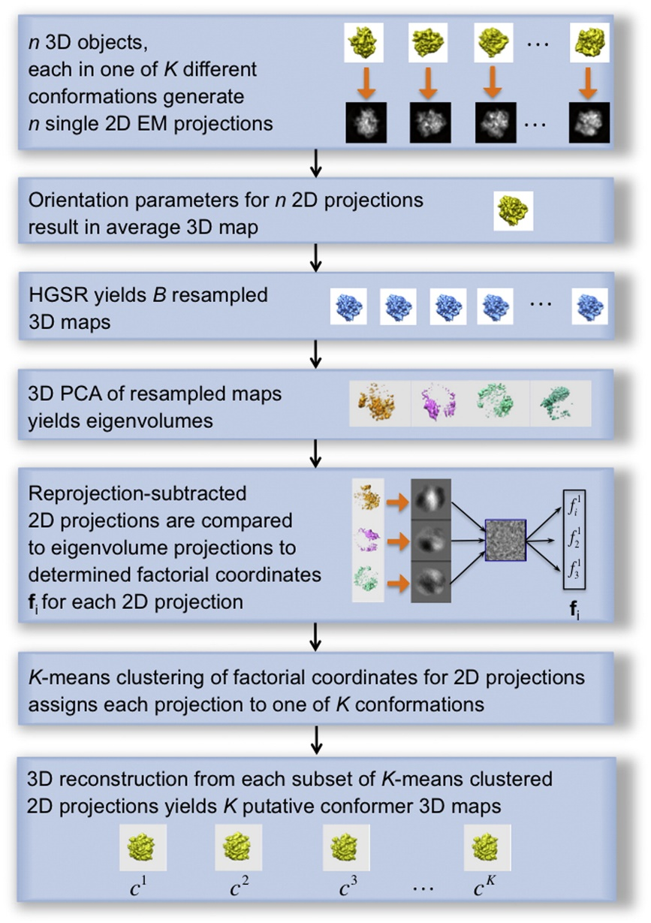
Eigen-Analysis [1]
Assume a 3D consensus model is derived
Orientations for each particle are known
HyperGeometric Stratified Resampling (HGSR) scheme
Bootstrap may result in non-uniform distribution
The resampled volumes may contain streak patterns
Using factorial (reaction) coordinate for clustering and continuous analysis
Resampling
Projection to latent space
<10
Clustering analysis
Notes:
HGRS resampling is stratified
https://github.com/cryoem/eman2/blob/master/sparx/libpy/applications.py#L17466

Slide 3
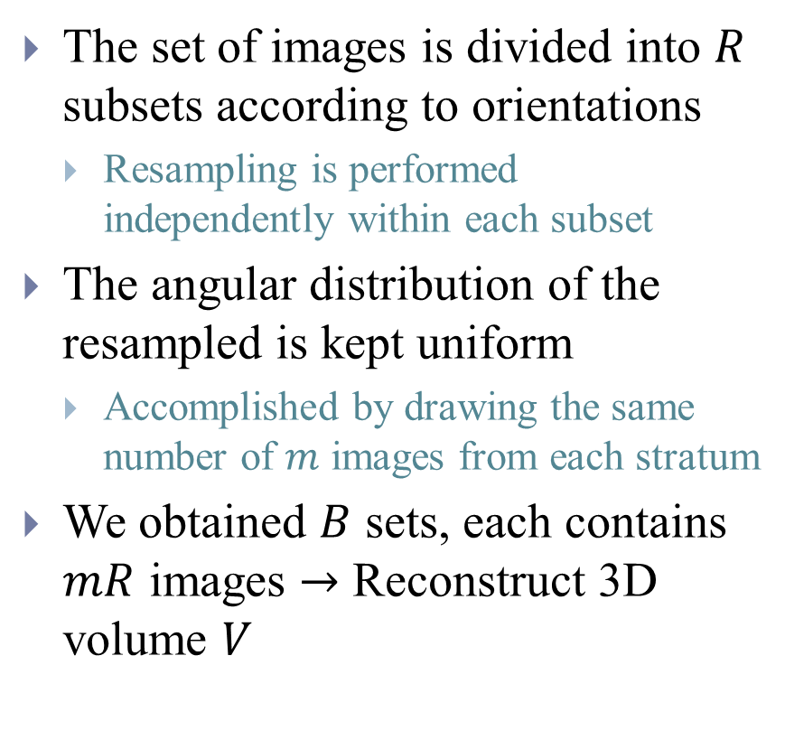
Eigen-Analysis [1] - HGSR
The set of images is divided into $R$ subsets according to orientations
Resampling is performed independently within each subset
The angular distribution of the resampled is kept uniform
Accomplished by drawing the same number of $m$ images from each stratum
We obtained $B$ sets, each contains $mR$ images $→$ Reconstruct 3D volume $V$

Slide 4
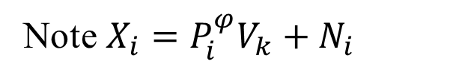
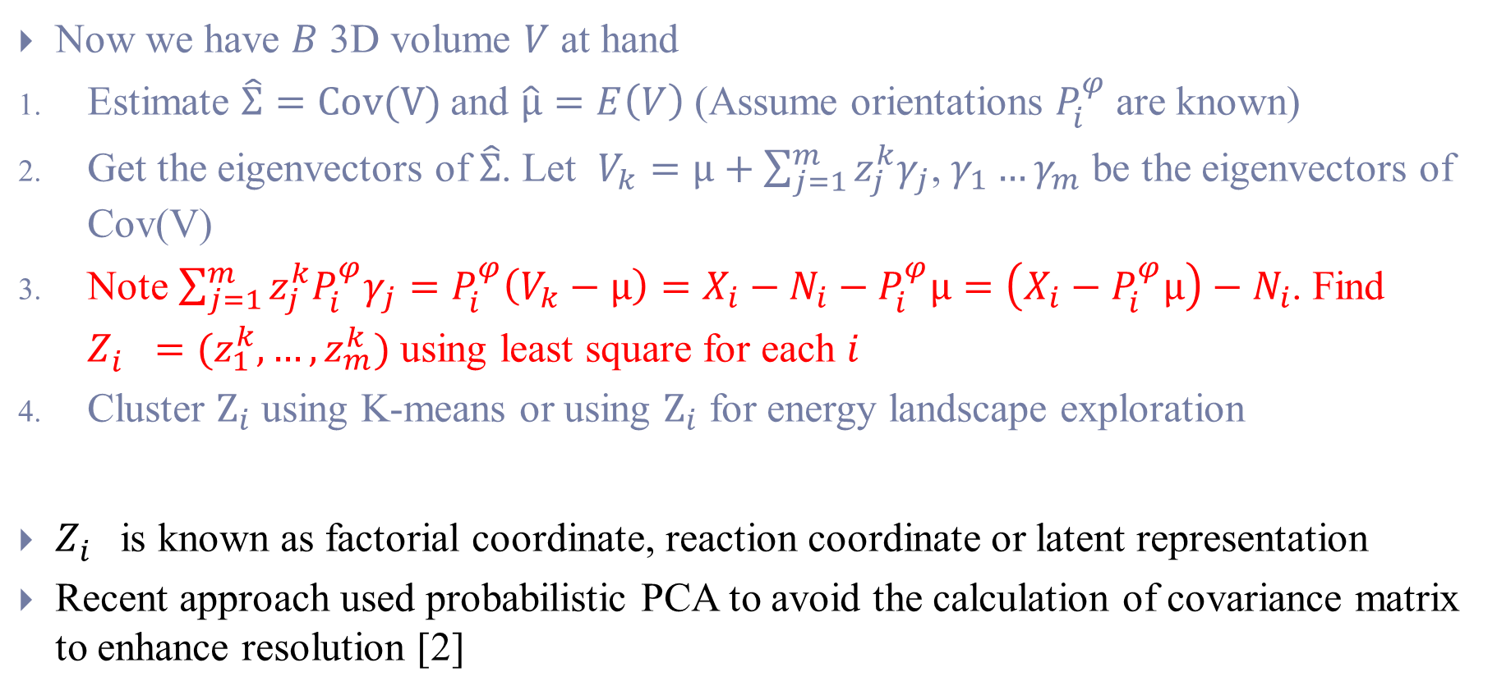
Eigen-Analysis - Projection
Note $X_{i}=P_{i}^{φ}V_{k}+N_{i}$
Now we have $B$ 3D volume $V$ at hand
Estimate $\hat{Σ}=Cov(V)$and $\hat{μ}=E\left(V\right)$ (Assume orientations $P_{i}^{φ}$are known)
Get the eigenvectors of $\hat{Σ}$. Let $V_{k}=μ+\sum_{j=1}^{m}{{z_{j}^{k}γ}_{j}}$, $γ_{1}…γ_{m}$ be the eigenvectors of Cov(V)
Note $\sum_{j=1}^{m}{{{z_{j}^{k}P}_{i}^{φ}γ}_{j}}=P_{i}^{φ}\left(V_{k}−μ\right)=X_{i}−N_{i}−P_{i}^{φ}μ=\left(X_{i}−P_{i}^{φ}μ\right)−N_{i}$. Find $Z_{i}^{}=(z_{1}^{k},…,z_{m}^{k})$ using least square for each $i$
Cluster $Z_{i}$ using K-means or using $Z_{i}$ for energy landscape exploration
$Z_{i}^{}$ is known as factorial coordinate, reaction coordinate or latent representation
Recent approach used probabilistic PCA to avoid the calculation of covariance matrix to enhance resolution [2]

Slide 5
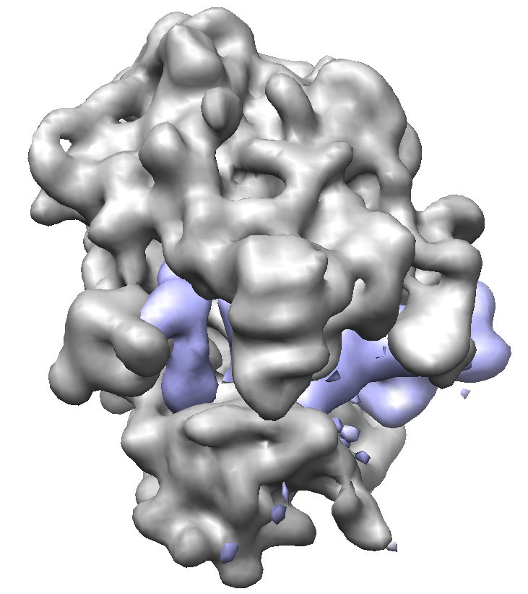
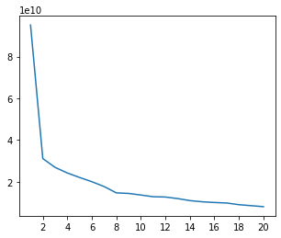
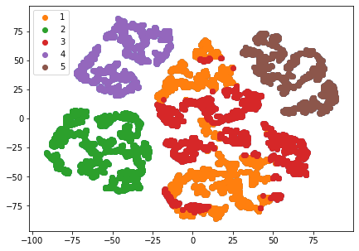
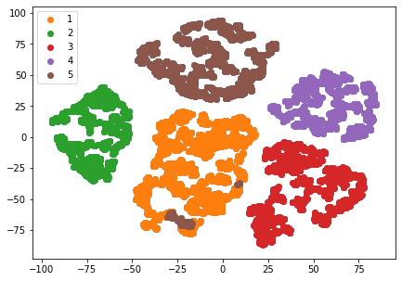

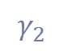
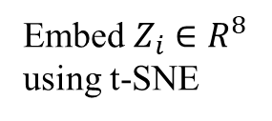
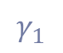
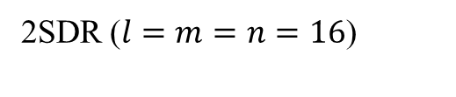
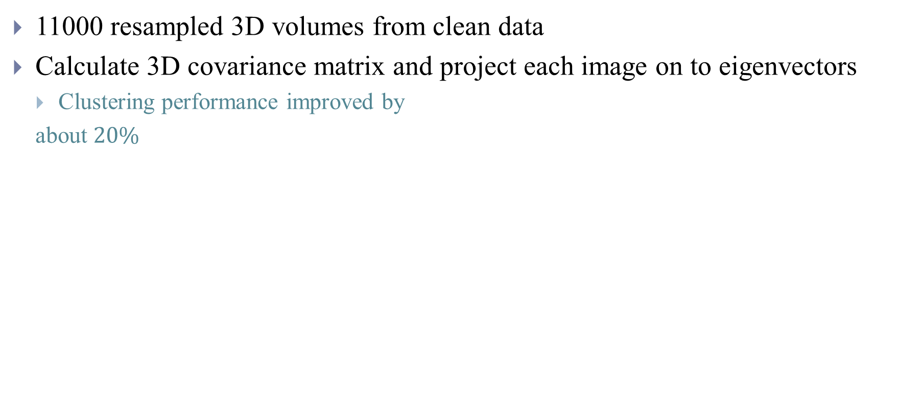
Eigen-Analysis - Cluster analysis of $Z_{i}$
11000 resampled 3D volumes from clean data
Calculate 3D covariance matrix and project each image on to eigenvectors
Clustering performance improved by
about $20\%$
PCA
2SDR ($l=m=n=16$)
$$γ_{1}$$
eigenvalue
$$γ_{2}$$
Embed $Z_{i}∈R^{8}$ using t-SNE
eigenvector
Notes:
$$, 0.8$$

Slide 6
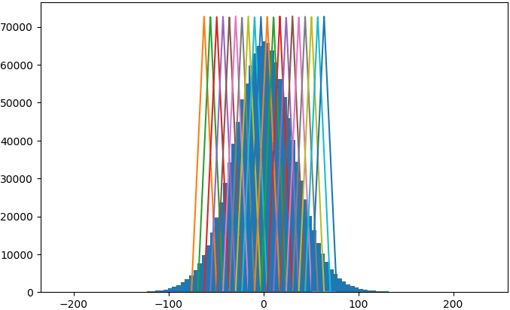
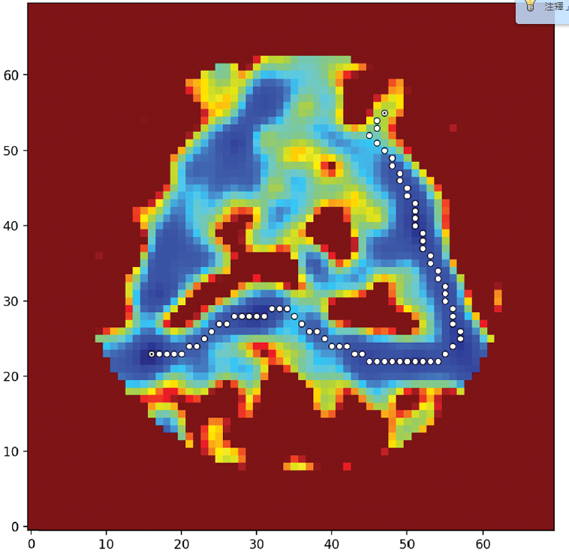

Eigen-Analysis - Continuous analysis of $Z_{i}$
Simple mode (Consensus structure plus a fraction of eigenvolume)
Intermediate mode (Separate weighted (kernel) reconstruction along a reaction coordinate)
Generate energy landscape and find Minimum Energy Path (MEP)
Notes:
https://www.notion.so/3D-Variability-Analysis-3DVA-5f351d70f18042e6b32c215372639335

Slide 7
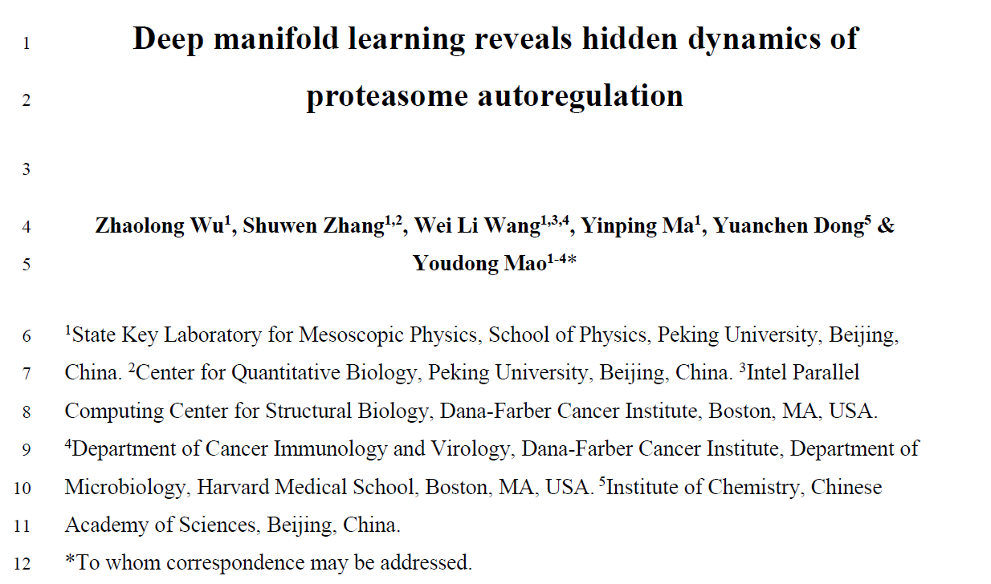
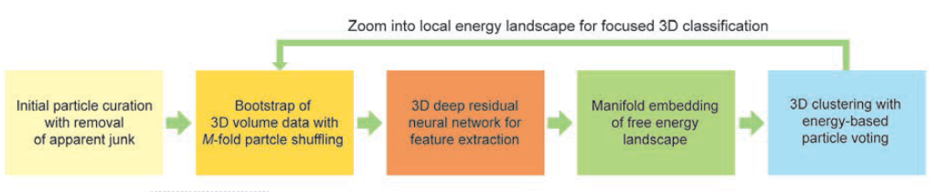
AlphaCryo4D [3]
Obtain consensus 3D volume

Slide 8
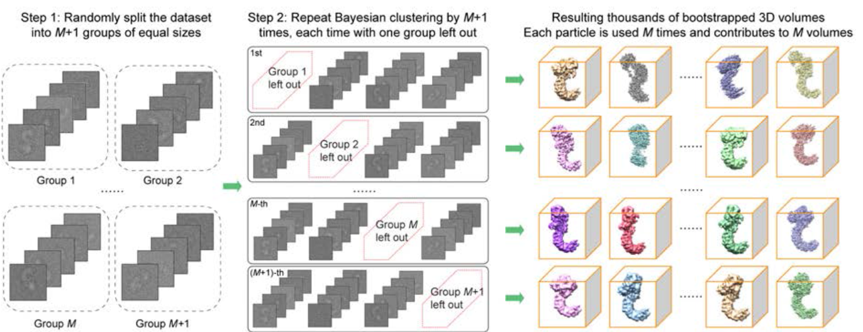
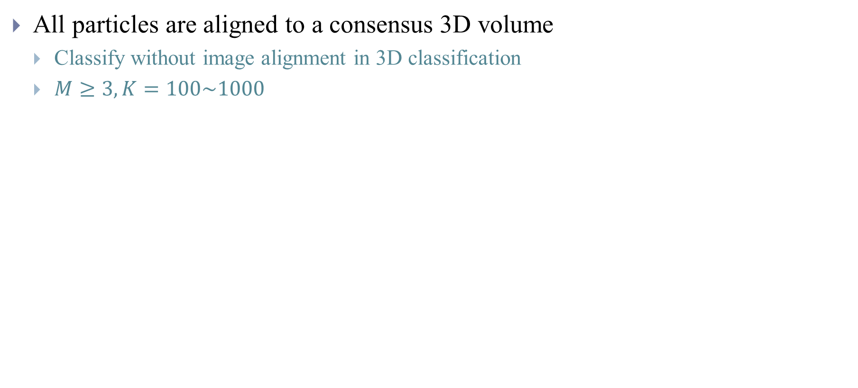
(1) Particle shuffling for 3D volume bootstrapping
All particles are aligned to a consensus 3D volume
Classify without image alignment in 3D classification
$M≥3, K=100\sim 1000$

Slide 9
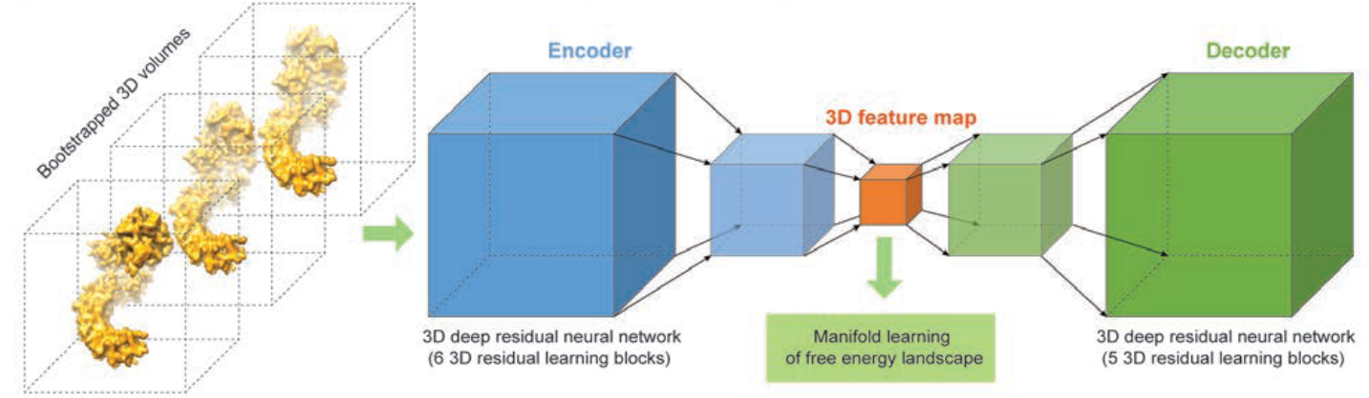
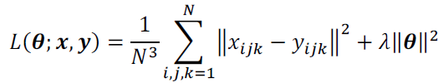
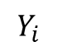
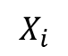
(2) Deep residual autoencoder
$$X_{i}$$
$$Y_{i}$$

Slide 10
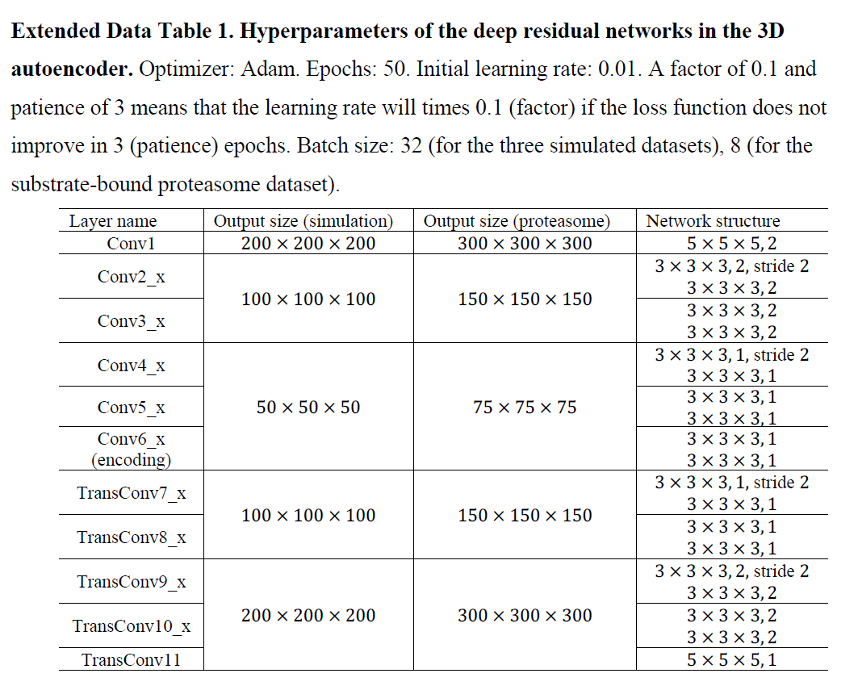

Slide 11

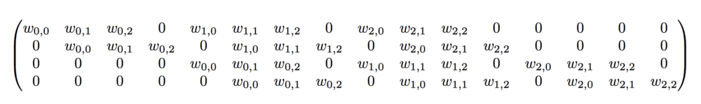

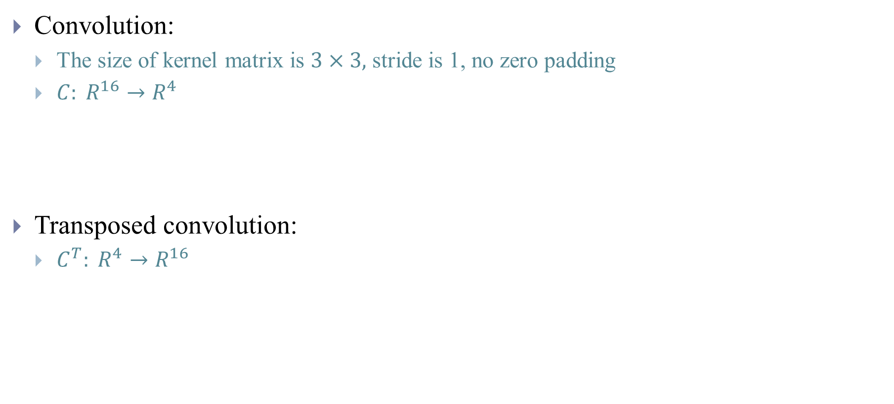
Convolution and transposed convolution [4]
Convolution:
The size of kernel matrix is $3×3,$ stride is 1, no zero padding
$C: R^{16}→R^{4}$
Transposed convolution:
$C^{T}: R^{4}→R^{16}$

Slide 12
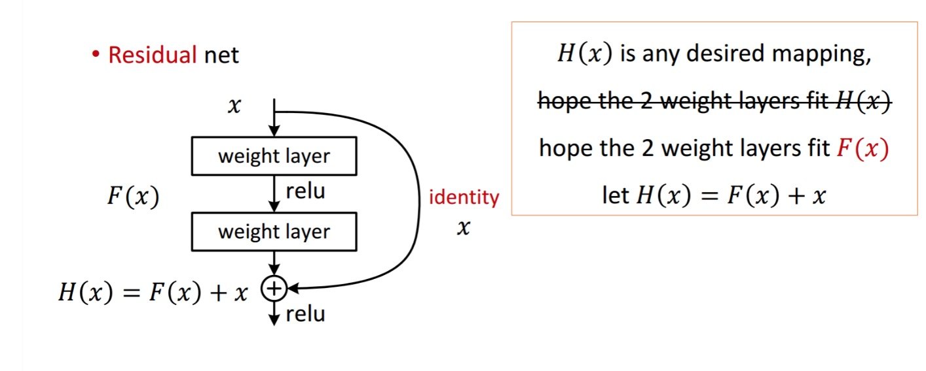
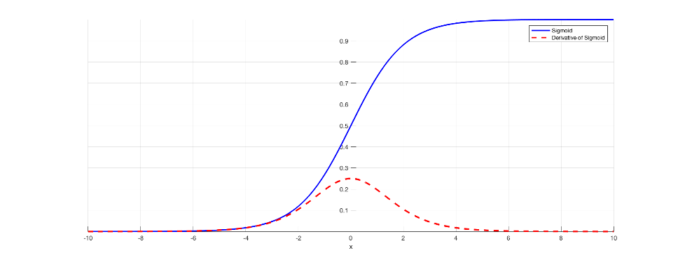
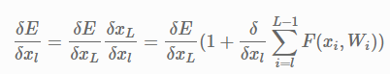
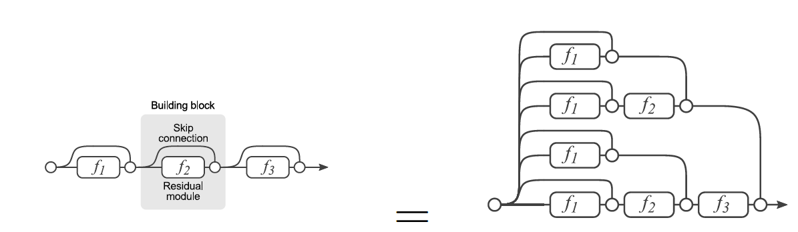
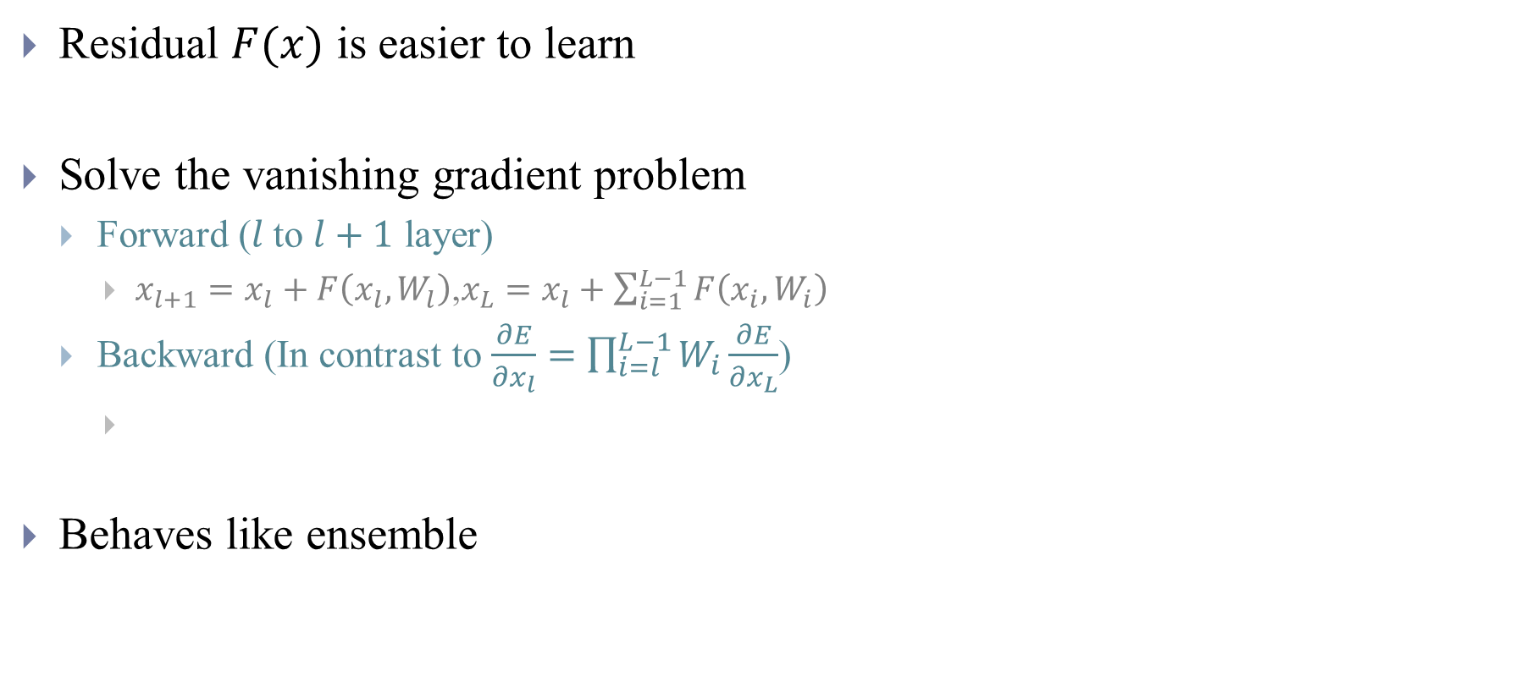
Residual learning [5-7]
Residual block
Residual $F(x)$ is easier to learn
Solve the vanishing gradient problem
Forward ($l$to $l+1$ layer)
$x_{l+1}=x_{l}+F\left(x_{l}, W_{l}\right)$,$x_{L}=x_{l}+\sum_{i=1}^{L−1}{F\left(x_{i}, W_{i}\right) }$
Backward (In contrast to $\frac{∂E}{∂x_{l}}=\prod_{i=l}^{L−1}{W_{i}}\frac{∂E}{∂x_{L}}$)
Behaves like ensemble
Notes:
https://shuzhanfan.github.io/2018/11/ResNet/
Regulization or sigmoid
若目標層其參數是不必要的，在增加 regularization term 時，會將目標層的權重參數和偏移參數縮小至零，若少了拷貝來源層的輸出，則目標層的輸出變為零，而造成學習上的困難。但因為多了拷貝來源層的輸出，而使目標層輸出為來源層輸出的非線性轉換，也就是來源層輸出本身
As one example of the problem cause, traditional activation functions such as the hyperbolic tangent function have gradients in the range (0, 1), and backpropagation computes gradients by the chain rule. This has the effect of multiplying n of these small numbers to compute gradients of the early layers in an n-layer network, meaning that the gradient (error signal) decreases exponentially with n while the early layers train very slowly.

Slide 13
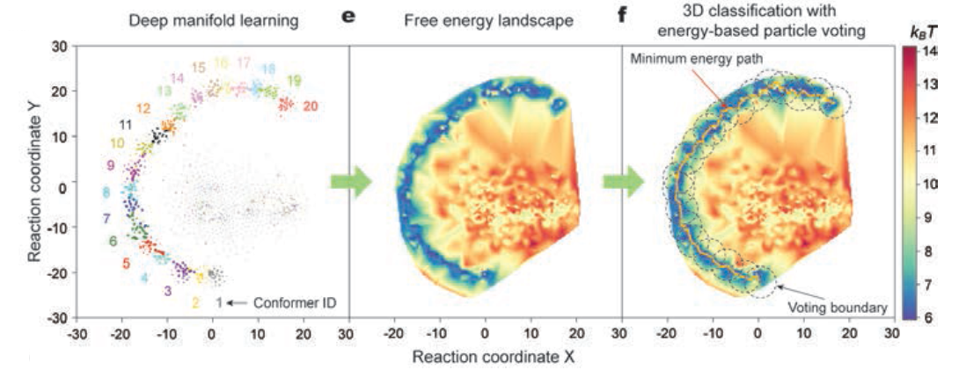
(3) Manifold embedding and path-finding
t-SNE is used to reduce dimensionality to 2

Slide 14
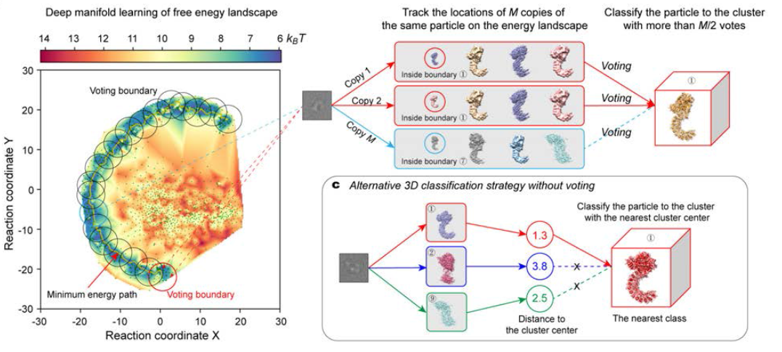
(4) Energy-based particle voting
Two approaches to discard particles

Slide 15
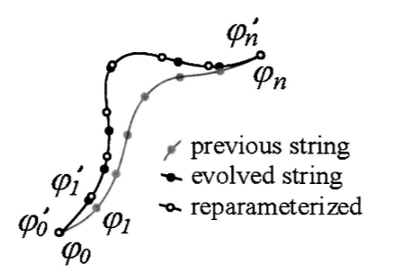
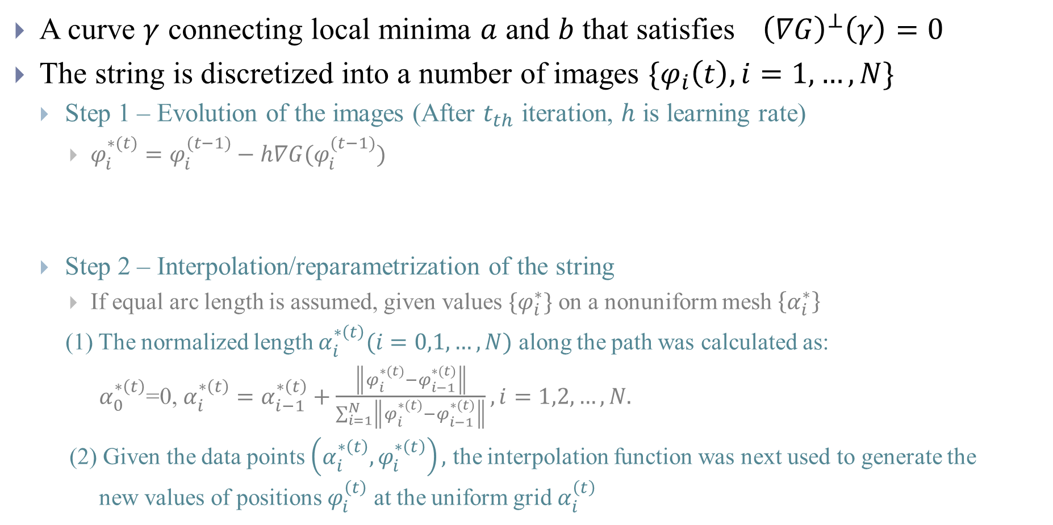
MEP finding (string or nudged elastic band method) [8]
A curve $γ$ connecting local minima $a$ and $b$ that satisfies${\left(∇G\right)}^{⊥}\left(γ\right)=0$
The string is discretized into a number of images $\{φ_{i}\left(t\right),i=1,…,N\}$
Step 1 – Evolution of the images (After $t_{th}$ iteration, $h$ is learning rate)
$φ_{i}^{∗(t)}=φ_{i}^{(t−1)}−h∇G(φ_{i}^{(t−1)})$
Step 2 – Interpolation/reparametrization of the string
If equal arc length is assumed, given values $\{φ_{i}^{∗}\}$ on a nonuniform mesh $\left\{α_{i}^{∗}\right\}$
(1) The normalized length $α_{i}^{∗\left(t\right)}(i=0,1,…,N)$ along the path was calculated as:
$α_{0}^{∗\left(t\right)}$=0, $α_{i}^{∗\left(t\right)}=α_{i−1}^{∗\left(t\right)}+\frac{\left\|φ_{i}^{∗(t)}−φ_{i−1}^{∗(t)}\right\|}{\sum_{i=1}^{N}{\left\|φ_{i}^{∗(t)}−φ_{i−1}^{∗(t)}\right\|}}, i=1,2,…,N.$
(2) Given the data points $\left(α_{i}^{∗\left(t\right)},φ_{i}^{∗\left(t\right)}\right),$ the interpolation function was next used to generate the new values of positions $φ_{i}^{\left(t\right)}$ at the uniform grid $α_{i}^{\left(t\right)}$
Notes:
$φ$ coordinate
Inner product
No projection
we would like to interpolate onto uniform mesh
To evolve the curve, use the force
$v_{n}=−{\left(∇V\right)}^{⊥}→\dot{φ}=−{∇V\left(φ\right)}^{⊥}+λ\hat{τ}=−{∇V\left(φ\right)}^{}+(∇V\left(φ\right),\hat{τ})\hat{τ}$ $+λ\hat{τ}$
$=−{∇V\left(φ\right)}^{}+\overline{λ}\hat{τ}$, where $λ\hat{τ}≡λ(α,t)\hat{τ}\text{(}α,t\text{)}$

Slide 16
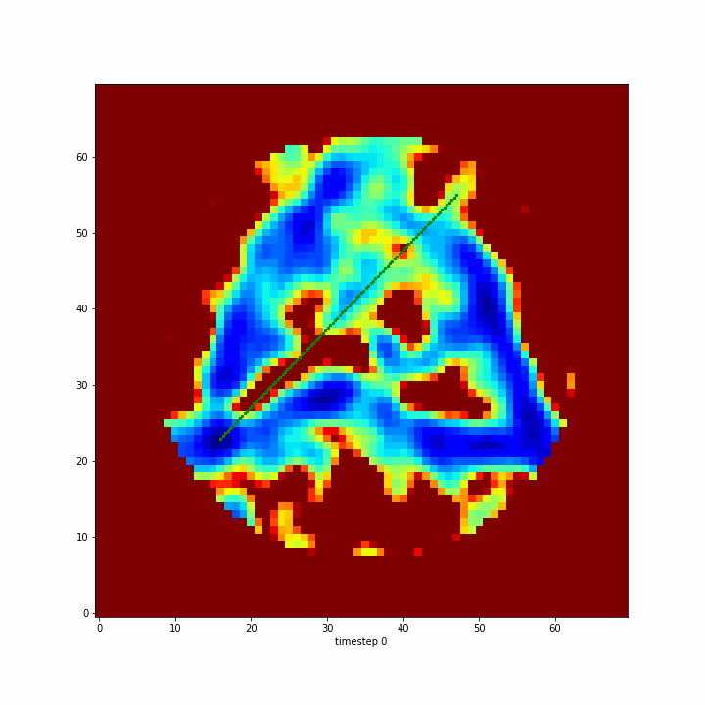
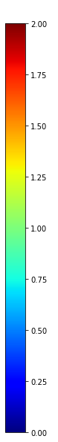
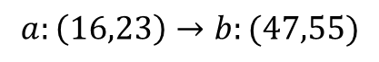
String method on example energy landscape
Data from https://github.com/evanseitz/POLARIS/tree/master/data_input
$$a:\left(16,23\right)→b:(47,55)$$

Slide 17
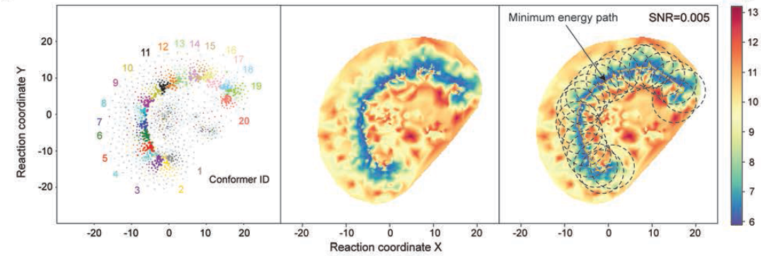
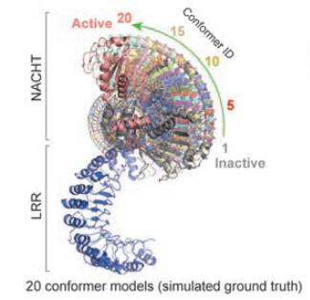
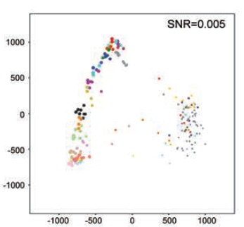
Synthetic dataset
2,000,000 particles (each conformation 100,000 particles)
Split into 20 subsets
3DVA
Notes:
200+ hours (320 GPU)

Slide 18
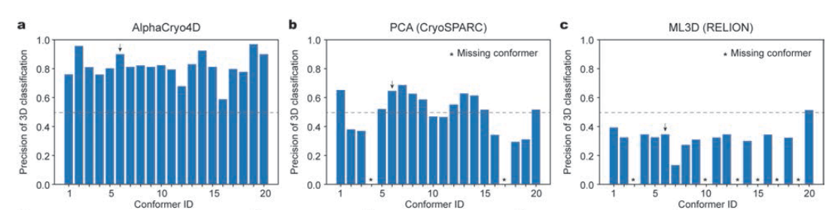
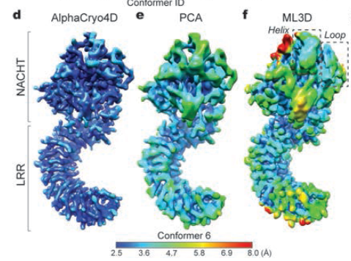
Compare to 3DVA and 3D classification in cluster analysis

Slide 19
Conclusion
The method reveals more variability of Proteasome
AlphaCryo4D
Use reproducibility to classify particles
Use autoencoder and t-SNE to generate energy landscape
Use string method to find MEP
Suitable for large dataset but the computation time is also long

Slide 20
References
[1] Penczek, Pawel A., Marek Kimmel, and Christian MT Spahn. "Identifying conformational states of macromolecules by eigen-analysis of resampled cryo-EM images." Structure 19.11 (2011): 1582-1590.
[2] Punjani, Ali, and David J. Fleet. "3D Variability Analysis: Resolving continuous flexibility and discrete heterogeneity from single particle cryo-EM." Journal of Structural Biology (2021).
[3] Wu, Z., Zhang, S., Wang, W. L., Ma, Y., Dong, Y., & Mao, Y. “Deep manifold learning reveals hidden dynamics of proteasome autoregulation.” arXiv preprint arXiv:2012.12854. (2020).
[4] Dumoulin, Vincent, and Francesco Visin. "A guide to convolution arithmetic for deep learning." arXiv preprint arXiv:1603.07285 (2016).
[5] He, Kaiming, et al. "Deep residual learning for image recognition." Proceedings of the IEEE conference on computer vision and pattern recognition. 2016.
[6] He, Kaiming, et al. "Identity mappings in deep residual networks." European conference on computer vision. Springer, Cham, 2016.
[7] Veit, Andreas, Michael Wilber, and Serge Belongie. "Residual networks behave like ensembles of relatively shallow networks." arXiv preprint arXiv:1605.06431 (2016).
[8] Weinan, E., Weiqing Ren, and Eric Vanden-Eijnden. "Simplified and improved string method for computing the minimum energy paths in barrier-crossing events." Journal of Chemical Physics 126.16 (2007): 164103.

